Slide 1

Course:
Introduction to Programming
Professor: Raghav Nayyar
Project Team Members
Jamshed
Vandana
Misbah
Faraaz
Prashant
Python Data Modeling Project for
Airbnb
airbnb.com
info@airbnb.com

Slide 2


INTRO TO FEATURES
Name
Hostname
Location
Latitude
State
City
Neighborhood
Number of Reviews
Host id
Availability
Price
Neighborhood Group
Minimum Nights
Longitude

Slide 3
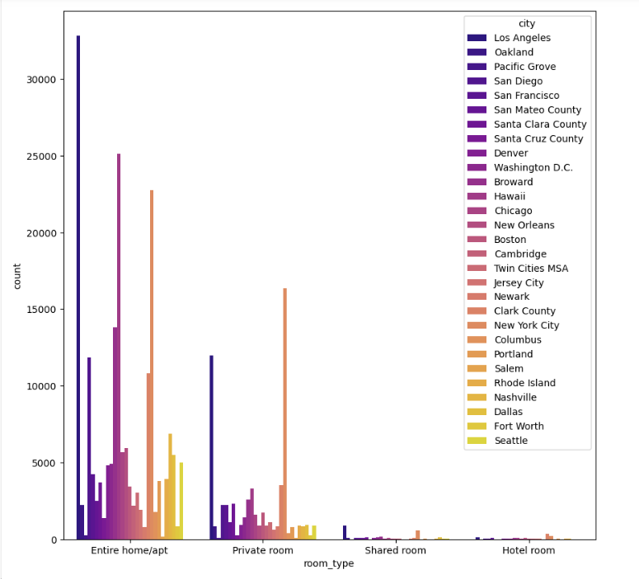

Plotting variations of property types per city
INSIGHTS
Entire home/apt and Private room are the most popular room types in the US
The count plot clearly shows Los Angeles as the top city with the most number of listings.

Slide 4

Data Cleaning

Slide 5


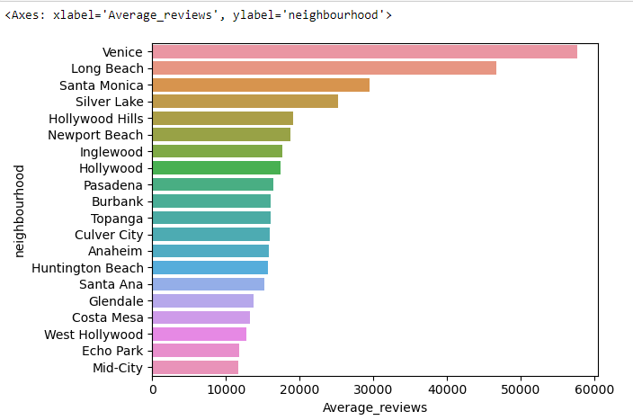
Popular Neighborhoods of Los Angeles
Top 5 neighbourhoods
Venice
Long Beach
Santa Monica
Silver Lake
Hollywood Hills

Slide 6


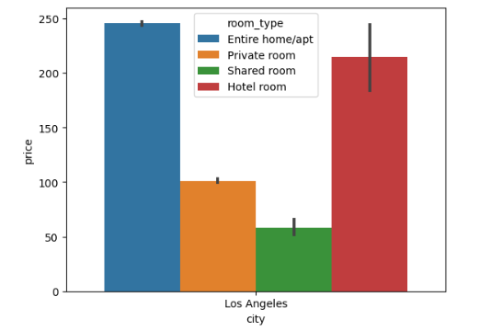
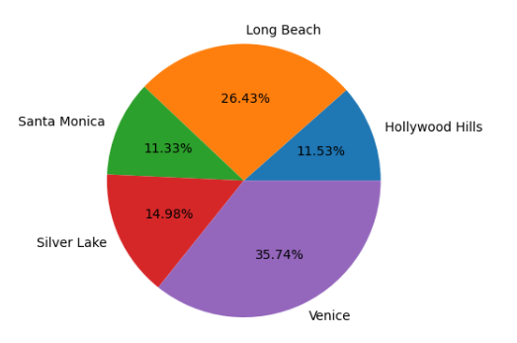

Room Types
Availability
Price
Reviews
Reviews

Slide 7
Reviews Diagnostics
Insights
Gain valuable insights from Airbnb user reviews and ratings to understand the preferences and expectations of guests. This analysis will enable us to identify trends and patterns that can be used to improve customer satisfaction and optimize pricing strategies.

Slide 8
Price Prediction Modeling
Predicting
Predicting Airbnb listing prices using machine learning.

Slide 9


Methodology
Data Collection
Modeling and Analysis
Gathered Airbnb data for popular neighbourhoods, room types, reviews, and prices
Used advanced data science techniques to predict prices based on various factors

Slide 10


Data Science Insights
Results
Key findings and insights from the data analysis revealed interesting patterns in popular neighbourhoods, room types, reviews, and price predictions. By applying advanced data science techniques, we were able to uncover valuable information that can drive strategic decisions and optimize the Airbnb experience for both hosts and guests.

Slide 11


Recommendations
Target neighborhoods
Target Property Type
Target Price Range per property type

Slide 12
Unlocking Insights
DATA-DRIVEN PREDICTIONS
Conclusion

